Slide 1
Update on DBNet
Nigel Atkinson
GODEX-NWP, 27-30 November 2018

Slide 2
Introduction
From WMO web page: The Direct Broadcast Network (DBNet) is a set of operational arrangements for the real-time acquisition of Low Earth Orbit (LEO) satellite data through a worldwide network of local, Direct Broadcast receiving stations and the rapid delivery of these data to the global user community after pre-processing and formatting in accordance with agreed standards.
See the Guide to DBNet: https://wis.wmo.int/DBNet-Guide

Slide 3
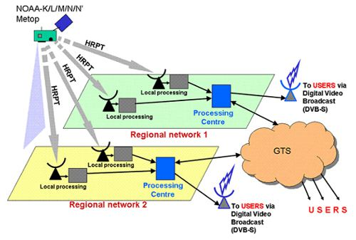
DBNet system concept

Slide 4
Main networks
Network | Coordinators | Services | Approx number of stations
EARS | EUMETSAT | ATOVS, IASI, AVHRR, ATMS, CrIS, VIIRS, MWHS-2, IRAS, ASCAT | 16
NOAA | SSEC/UW/CIMSS | IASI, ATMS, CrIS | 13
Asia-Pacific | JMA and BoM | ATOVS, (IASI, ATMS, CrIS) | 13
South America | INPE and CONAE | ATOVS, (IASI, ATMS, CrIS) | 4

Slide 5
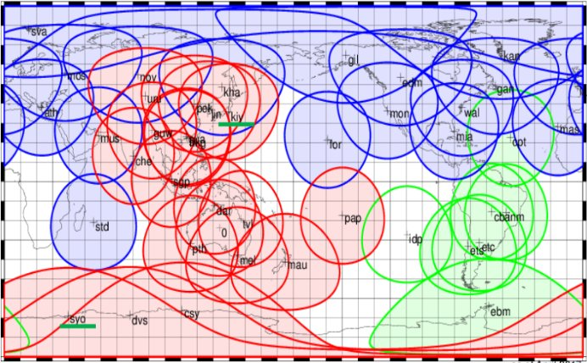
Station locations
Map courtesy of JMA
A few recently-added stations are not shown

Slide 6
What’s new since last GODEX-NWP?
Expansion of the NOAA network (ATMS, CrIS, IASI)

Slide 7
Plus Easter Island and Pretoria
– they send raw data to SSEC for processing and onward dissemination

Slide 8
What’s new since last GODEX-NWP?
Expansion of the NOAA network (ATMS, CrIS, IASI)
More stations are contributing ATMS and CrIS
Tahiti, Cuiaba (Brazil), Cachoeira Paulista (Brazil), Jincheon (Korea)

Slide 9
What’s new since last GODEX-NWP?
Expansion of the NOAA network (ATMS, CrIS, IASI)
More stations are contributing ATMS and CrIS
Tahiti, Cuiaba (Brazil), Cachoeira Paulista (Brazil), Jincheon (Korea)
New satellites launches: NOAA20, Metop-C, FY-3D
NOAA-20 received at most of the NOAA and EUMETSAT stations
CrIS disseminated in FSR format (431 channels)
Awaiting processing software from CMA for FY-3D
MWTS-2 and MWHS-2 can be established as DBNet services
Consider HIRAS when NWP centres have evaluated the data. BUFR sequences needs to be defined
Consider adding MWRI as part of DBNet
AAPP v8.3 has the Metop-C instrument calibration files

Slide 10
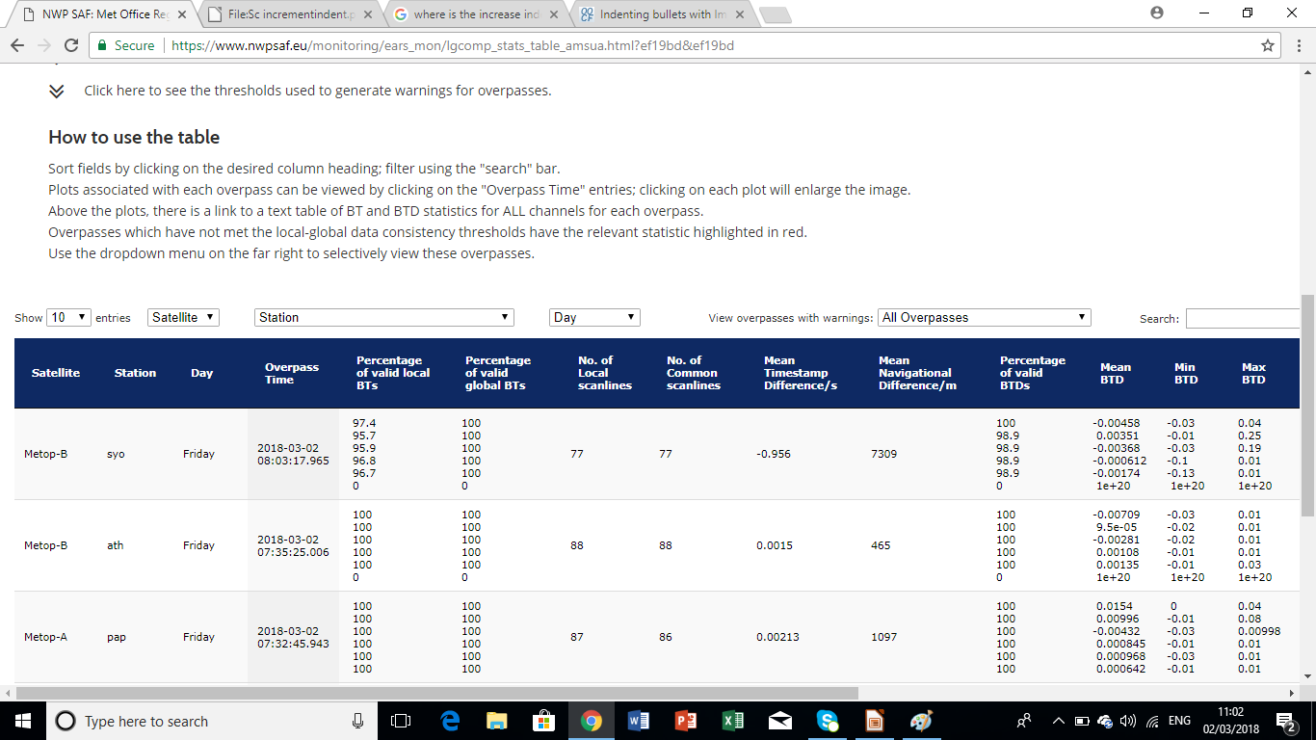
NWP SAF monitoring: new-look web pages
Table is the main user interface
Select specific stations, satellites or passes that generated warnings
Click on a pass to plot it
Can sort by column headings
New columns

Slide 11
Satellite priorities for DBNet
How does a DB station handle satellite conflicts? (i.e. where 2 or more satellites compete for the same antenna)
Trade-off between many factors, including:
Availability of local processors
Instrument health
Coverage and quality of direct broadcast
Impact on NWP (depends on many factors – including orbits, see next slide)
Timeliness of the global data
Local station needs (e.g. for imagery)

Slide 12
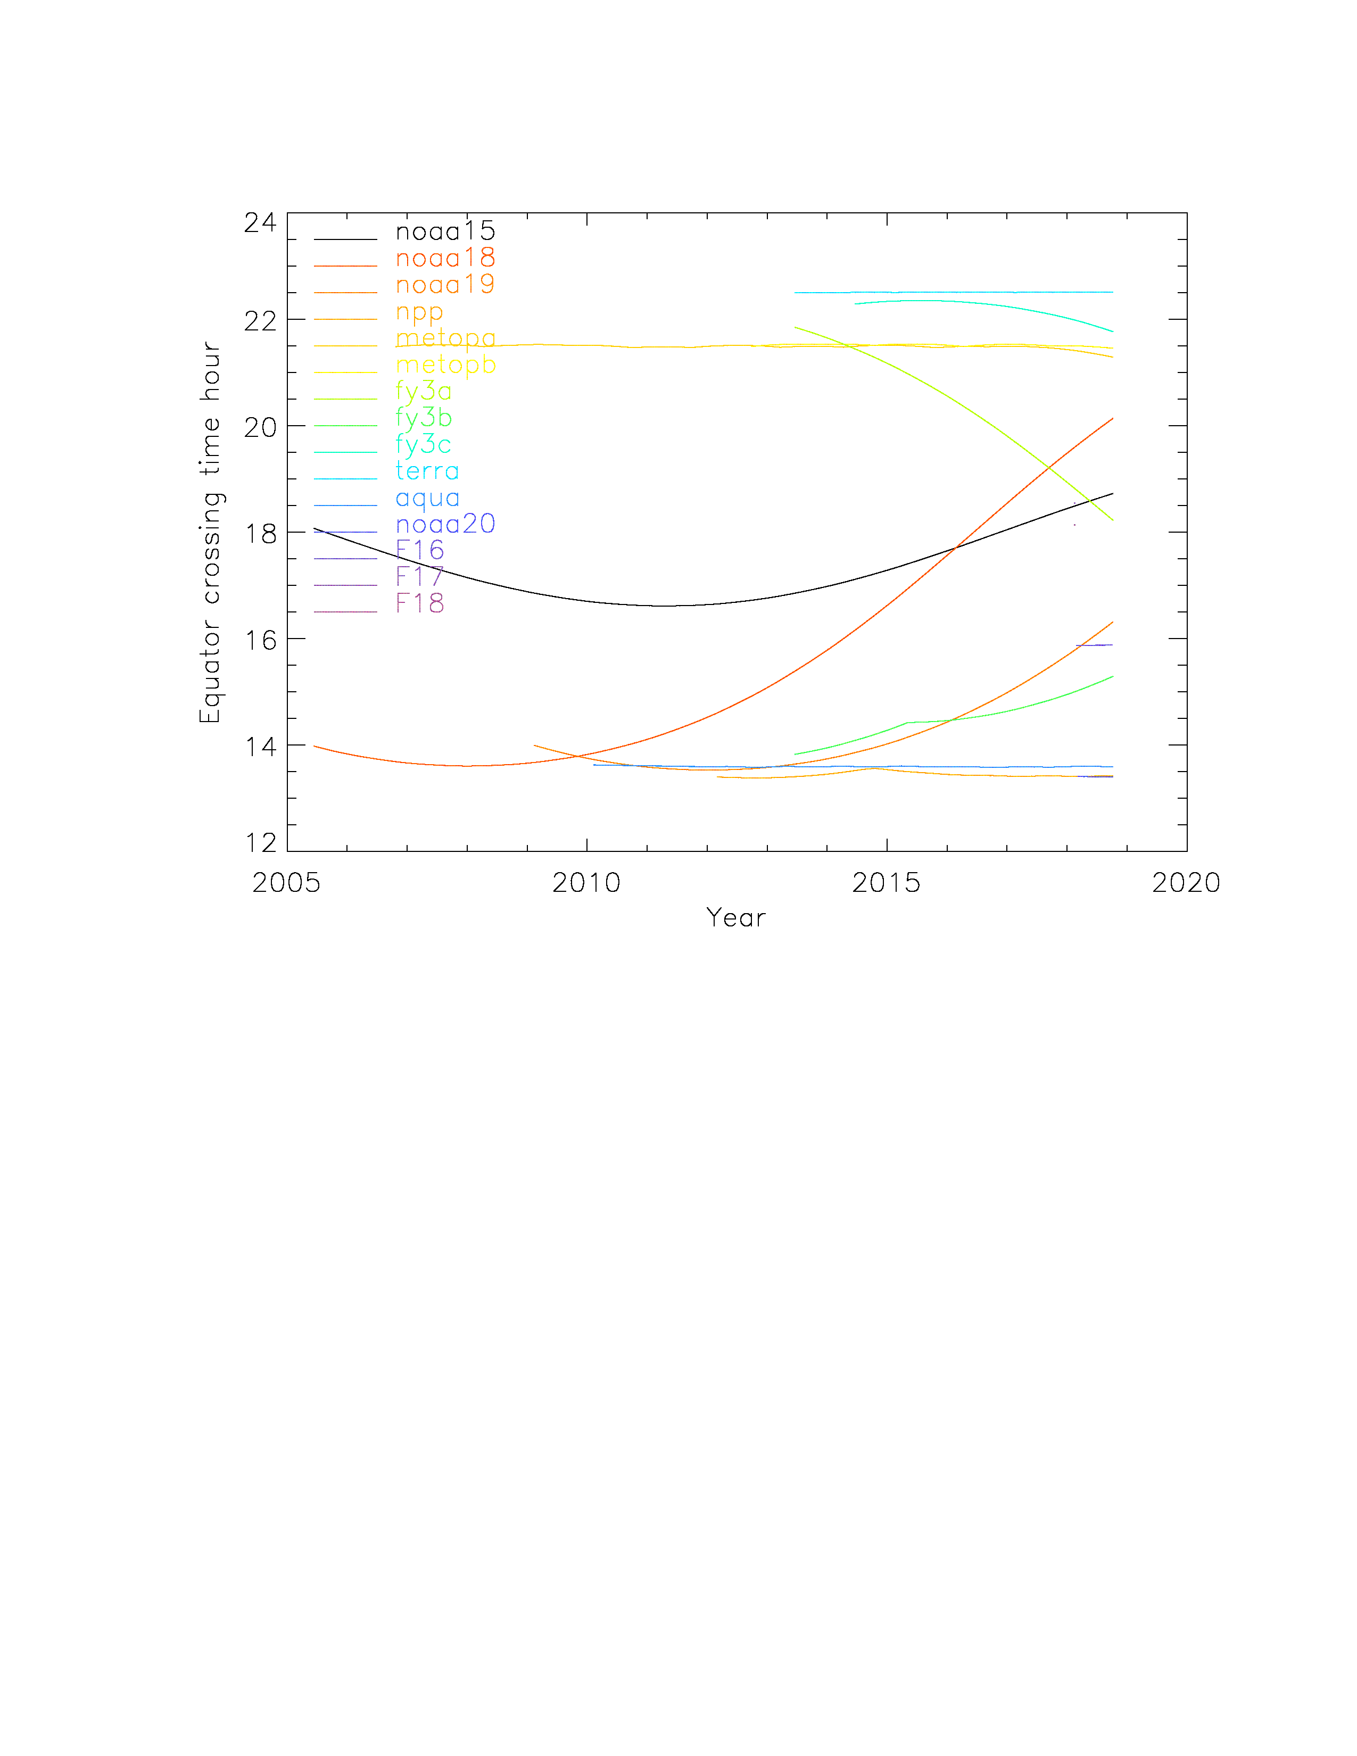
Equator crossing times
Terra
FY-3C
Metop-A/B
NOAA-18
Well-separated orbits are preferable, but NWP studies have shown benefits even when 2 instruments are in a similar orbit.
NOAA-15
NOAA-19
FY-3B
Aqua
NOAA-20 and S-NPP
Since last GODEX-NWP…
NOAA-15 dropped – downlink quality very poor
NOAA-19 moving towards well-separated late afternoon position
NOAA-18 is now only ~1 hour before the Metops
Launch of NOAA-20 – same orbit as S-NPP (different phasing)
Metop-A starting to drift, as orbital manoeuvres have ended

Slide 13
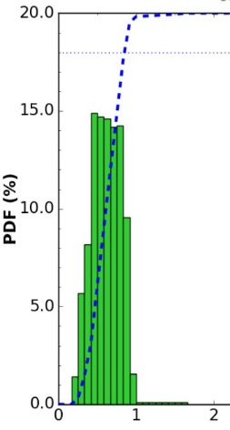
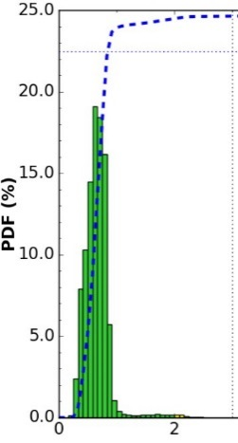
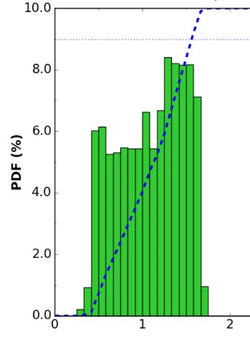
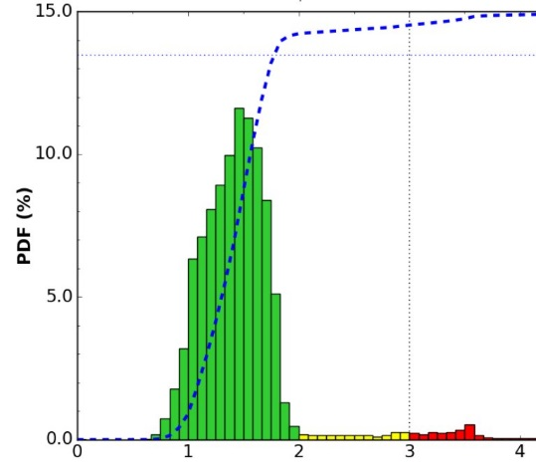
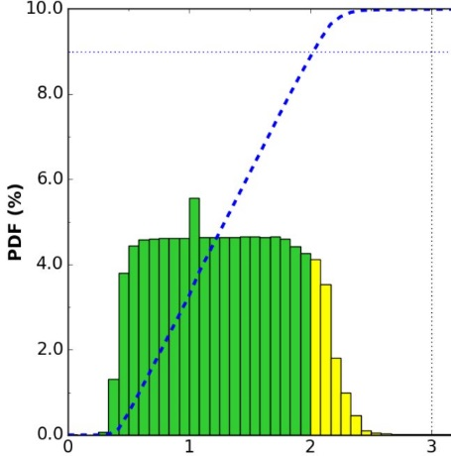
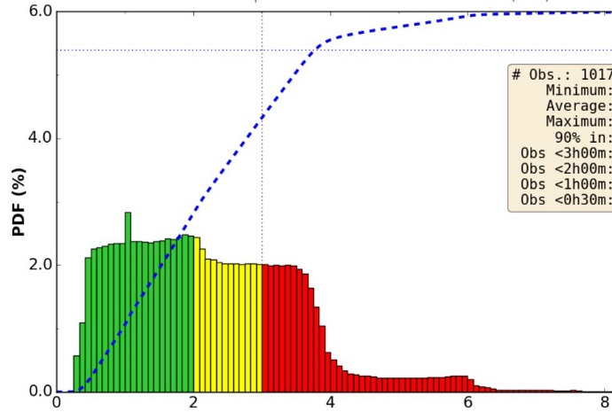
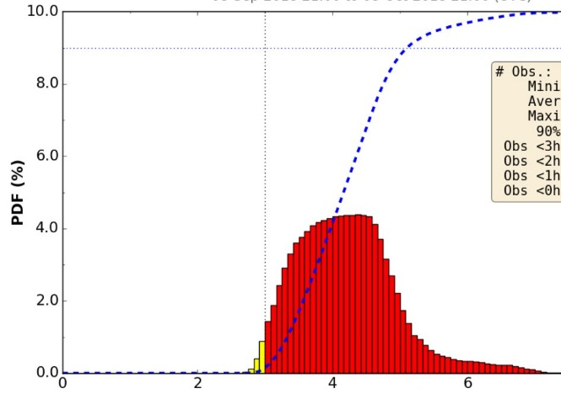
Timeliness of the global data (from
M-B: 0h 50m
N20: 0h 50m
M-A: 1h 33m
NPP: 1h 48m
N19: 2h 03m
Times quoted are for 90% of total data, over 1 month, by DWD
AMSU, ATMS, MWHS-2
Plots taken from NWPSAF web site
N18: 3h 48m
FY3C: 5h 8m

Slide 14
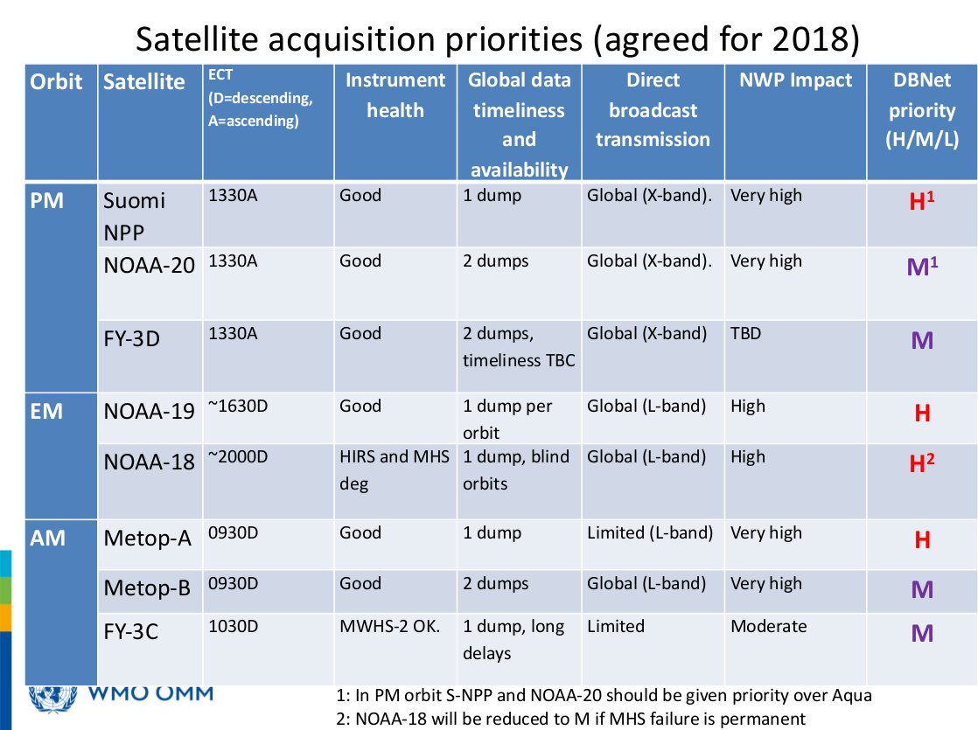

Slide 15
Some current DBNet issues
FY-3C currently only received in EARS network. Encouraging other networks to participate.
Need processing software from CMA for FY-3D
CMA have defined new BUFR sequences for MWHS-2, MWTS-2 and IRAS (3-10-070, 71, 72 respectively). Already in use for global data on GTS. Need to adopt for DBNet also.
User requirement for MWRI data as part of DBNet? Technically, it should be easy to add, if a station is already processing MWHS-2.
No new BUFR sequence yet for MWRI. This will be needed.
Left-hand circular polarisation for FY-3E (some reception stations will not be able to receive it)
Migration from CrIS NSR to FSR for Suomi-NPP – time scales? Spring 2019?

Slide 16
Questions and discussion?

